Slide 1



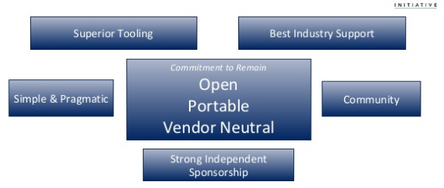

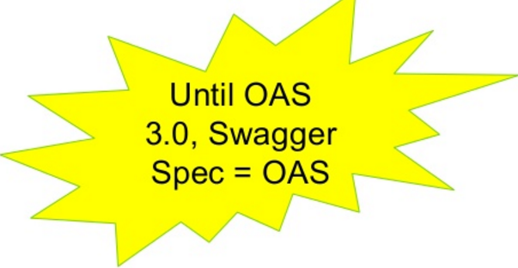
=

Slide 2
=
Version | Date | Notes
3.0 | Quarter 4 2016 | Release of OpenAPI Spec 3.0
2.0 | 2014-09-08 | Release of Swagger 2.0
1.2 | 2014-03-14 | Initial release of the formal document.
1.1 | 2012-08-22 | Release of Swagger 1.1
1.0 | 2011-08-10 | First release of the Swagger Specification
1.2 uses 2 files and 2.0 consolidated to 1 file.
3.0 is a major breaking change de-swagger the spec

Slide 3
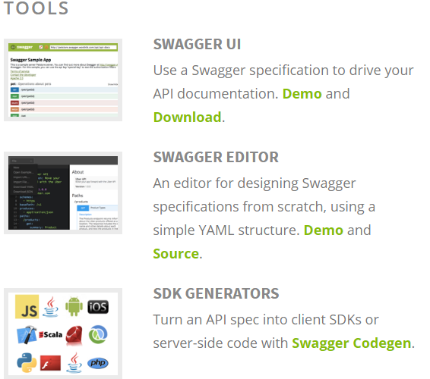

=
Swagger Tools
Spec Improvements Supported
Spec Usability
Editor/Code Generator
Visual UI
Better Tooling in 2.0
2.0 UI is backwards compatible with 1.2

Slide 4
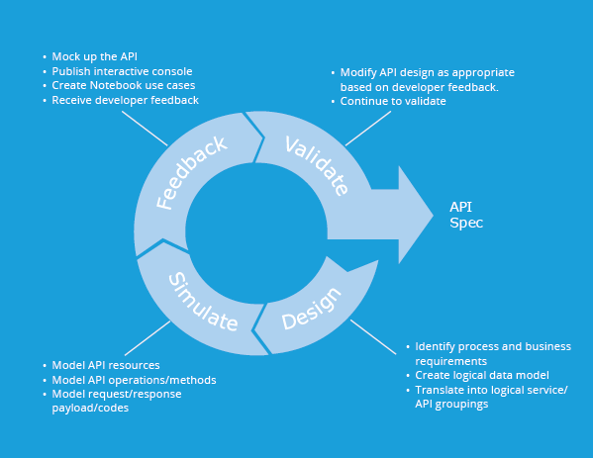

=
Web API Lifecycle

Slide 5
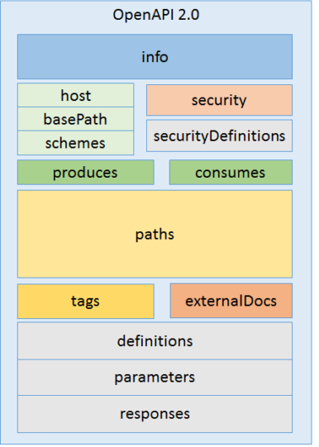
=
Swagger Spec
OpenAPI Specification version 2.0

Slide 6
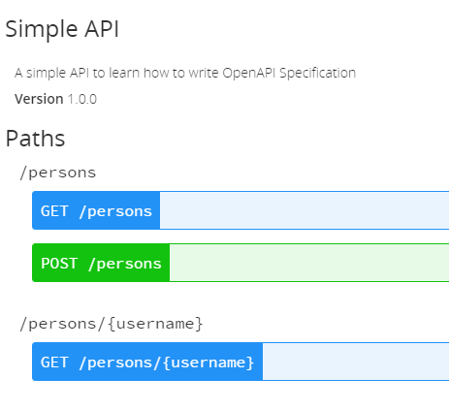
=
Simple API

Slide 7
=
Helpful Links
http://swagger.io/
https://www.openapis.org/
http://petstore.swagger.io/
http://editor.swagger.io/#/
https://apihandyman.io/writing-openapi-swagger-specification-tutorial-part-2-the-basics/
http://openapi-specification-visual-documentation.apihandyman.io/
https://apihandyman.io/openapi-trek-api-days-london-2016/
https://www.getpostman.com/

